Slide 1
A humble request to all, Please ask questions or doubts at the end of the presentation. You can note down the slide number given at the bottom-right corner of every slide.

Slide 2
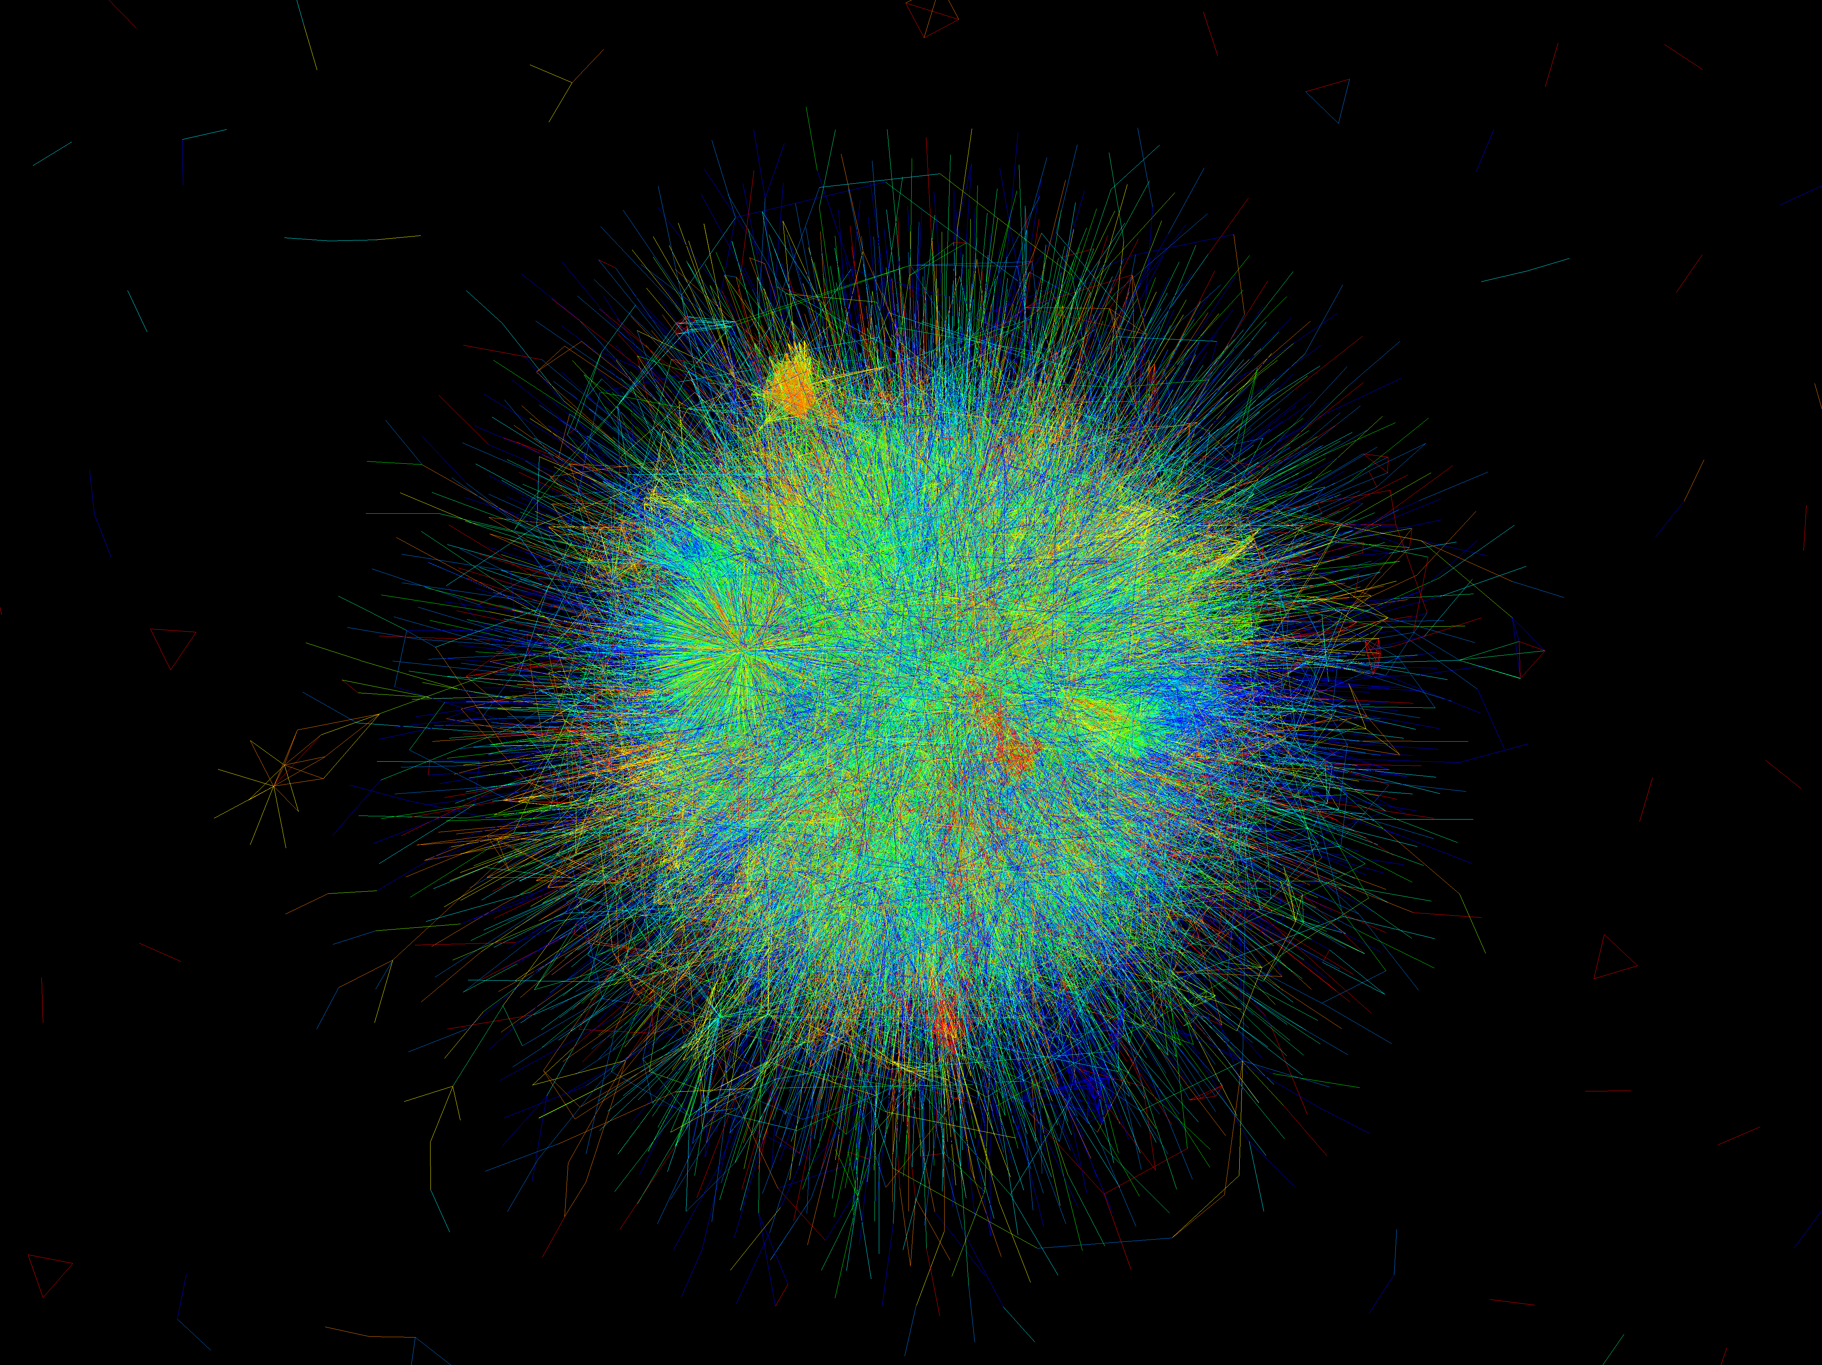
Simulation of Prokaryotic Genetic Circuits
Abhinav Mishra
131503 | 7th Semester

Slide 3
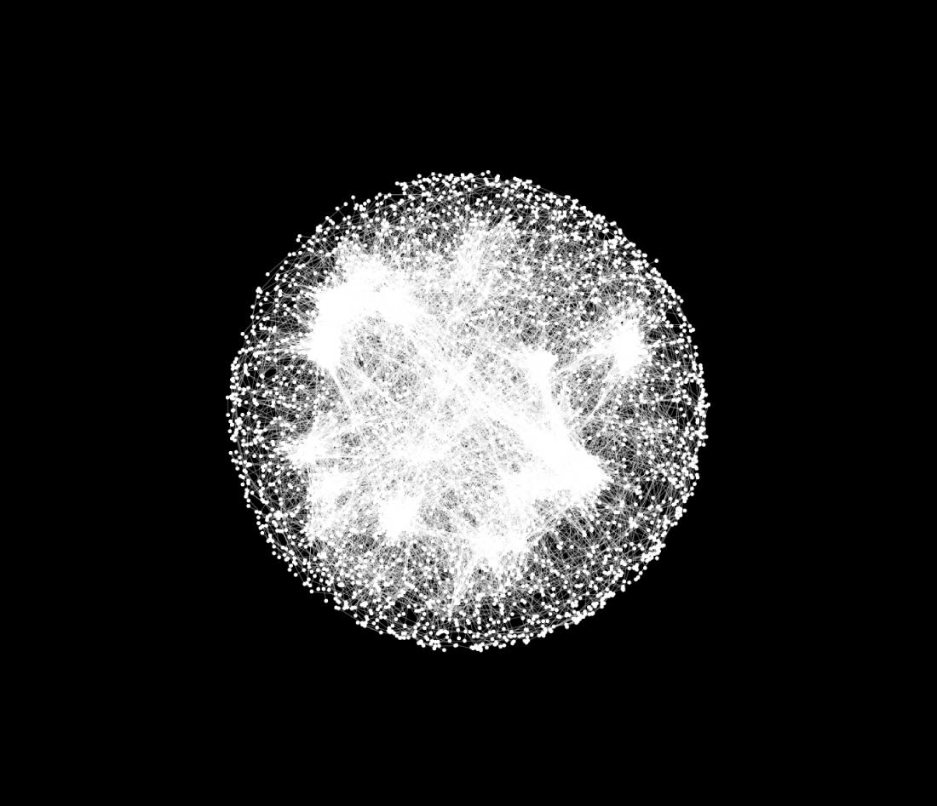
Overview
Organization of Genetic Regulatory Circuits
Simulations of Cellular Regulation
Modelling

Slide 4
Why Simulations are needed ?
To identify design principles for the biochemically based logic.
To understand the dynamical response of both normal and mutant cells to environmental and interval signals.
To predict quantitative effects of mutations on regulatory outcomes.
To verify consistency and completeness of hypotheses reactions systems.

Slide 5

What are the challenges in Simulations ?
Developing simulation techniques applicable to cellular processes where genetic regulation is centrally important.
Developmental Differentiation
Facultative Infection Process
Cell Cycle Control
In ’61 Cold Spring Harbor Conference on cellular Regulatory Mechanism, regulatory nets are characterized as ‘Circuits’.

Slide 6
Regulatory circuits
Hierarchical organization
Regulons – control groups of operons
Global regulons – multiple pathway regulation (e.g. IHF , σ³² )
Often neglected in simulations
However , needed in some circumstances (e.g. 2 σ factors competing)
Notes:
These Global Regulators enables the bacterial cell to effect a rapid and coordinated response to threats or opportunities by reconfiguring their Biochemical Machinery.
Biochemical Logic provides real- time regulatory control, implements a branching decision logic and executes stored programs that guide cellular differentiation extending over many cell generations.
These mechanisms that implements Bacterial genetic logic functions may be entirely within a single cell, may span many cells or may function across cell generations.
Multi-reagent reactions or Genetic Mechanism controlled by multiple input signals are the key elements for performing control logic function in these networks.

Slide 7
Regulatory feedback
Output influences input signals
Auto regulatory feedback loops
In E.coli, there are 107 σ⁷⁰ promoters
68% auto regulating
13% auto activating
Specialized enzymes often under regulatory control
Notes:
Cellular Regulatory Apparatus
It includes both short and long-term memory mechanisms
Note: The state of being either integrated or not into the host DNA acts as a memory element.
Genetic Regulatory Networks progress asynchronously through successive reactions. The Stochastic (arising from a random process) of protein production may only cause uncertainty in timing of regulatory events, not in outcome.
In a 1991 inventory of 107 σ70 promoters then known in Escherichia coli (10), the promoters were organized into 31 regulons, each jointly controlled by one or more regulatory proteins.

Slide 8
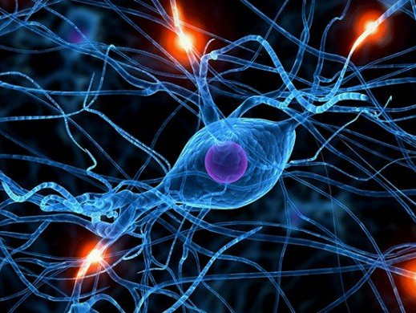
What defines the logic that how well the cell functions at any instant?
Complement of distinct molecules in the cell
State of DNA | Methylation or Demethylation

Slide 9
Notes:
Table 1
It shows the points of similarity between Genetic Logic and the electronic logic in chip in today’s desktop computers.

Slide 10
Genetic Cascade
Notes:
Figure 1.
(a) A genetic cascade, the simplest genetic circuit. The increasing concentration of signal protein A from transcripts initiated at promoter P_{A}, turns on the downstream promoter P_{B}, leading to production of signal Which similarly activates production of signal C. Signal speciﬁcity depends on the addressing created by stereo chemically based binding speciﬁcity of A, B, and C to the corresponding binding sites in the different promoters.
(b)The resulting succession of concentration peaks for signals A, B, and C. Decay of the protein signals after the promoters are switched off results from proteolytic degradation of the proteins and also in growing cells from continuous dilution of signal concentration as the cell size increases.

Slide 11
Regulatory mechanisms
Notes:
(c) A small sampling of the numerous additional regulatory mechanisms used in cells to control creation, timing, and decay of protein signals. Posttranscriptional regulatory mechanisms are essential features of regulatory networks and must be included in any analysis of the regulatory logic. Small auto regulatory feedback loops are widely used in cells to maintain signals within a concentration range. Switching circuits that control developmental path choices commonly include positive or reinforcing feedback to enhance the commitment to the selected path and negative or repressing feedback to assure that promoters on alternative paths are turned off.
The genetic regulatory mechanisms are of primary concern in this review and the coupled protein reaction- based regulatory networks together implement the control-system that enables cells to adapt to their environment.
Additional Adaptive capability:
Mutation and selection driven evolution of the regulatory circuit design.
Acquisition of new functions through horizontal exchange of mobile genetic elements by bacterial conjugation, transformation and transducers.

Slide 12
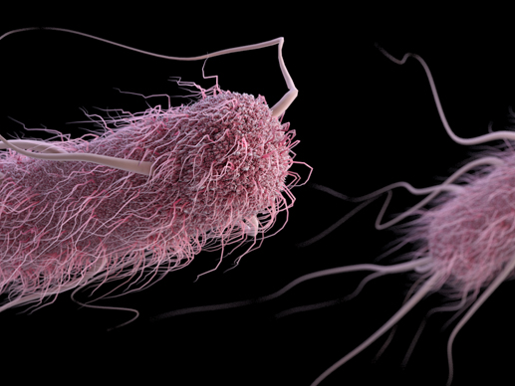
Integrating environmental signals
Chemotactic responses
Attractant or repellent molecules bind directly to specialized receptors leading to phosphorylation cascade
Pulses of agents matched with behavioural changes
Mutants shown to have altered enzymatic activity
Notes:
Bacterial Chemotactic Response is attracted or repellent molecules bind to specialized receptors on the cell surface and initiate a phosphorylation cascade that controls the rotary flagellar ‘motor’.
Phosphorelay- based Chemo Stasis Signaling Network
Reproduced the observed pattern of runs, tumbles, and pauses, matched pulses of chemo static agents.
Matched behavioral changes in chemo static mutants with altered enzyme activity.

Slide 13
Cell cycle models
Genetic regulation coupling to cell cycle
Modelling of biochemical reactions that support oscillations
p³⁴activation, p³⁴/cyclin interactions and cyclin degradation suggested
However shown to be far more elaborate
Notes:
Hyver and Le Guyader

Slide 14
Developmental Switches
Different physiological states require switching mechanisms
Cell-density-dependent gene expression
Quorum-sensing
Higher density = Higher peptide Pheromone concentration
Lytic/Lysogenic determination
Notes:
The mechanism for initiating switching between states are composed of transducers on the cells surface that detect external signals, internal structures signals, internal signaling pathway and the regulatory switching circuitry.
Quorum-sensing involves sensing of pheromones that is detectable by surface- bound receptor.

Slide 15
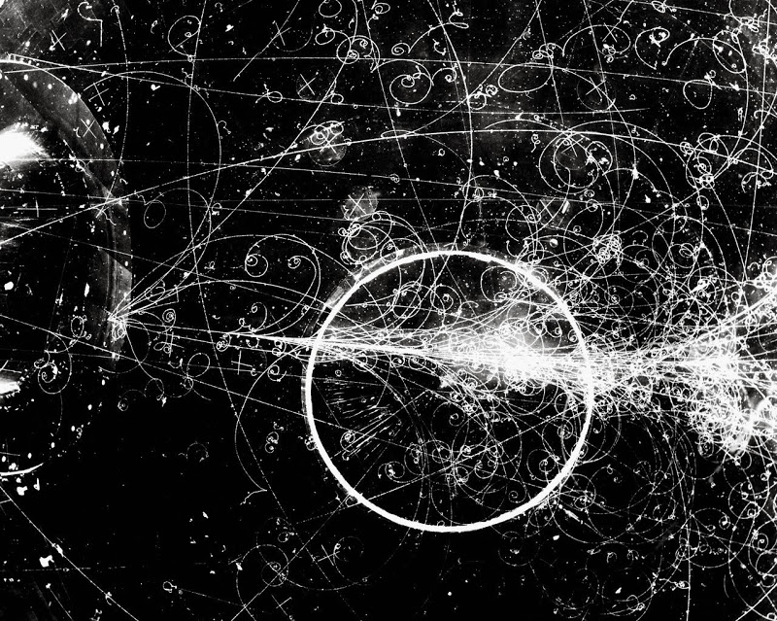
Modelling
Promoter control Models
Stochastic processes in regulatory kinetics
Modelling macromolecular complexes
Uncertainty in intracellular environment and reaction rates

Slide 16
Promoter Control Models
X_{i} is the concentration of i^{th} protein species
$\dot{X}$ is the time derivative of X_{i} i.e. $\dot{X}= \frac{dXi}{dt}$
k_{di} is the degradation rate constant for protein type i
k_{i} is the rate of protein production with gene type i is ON
F_{i} is the step function assumed to be 0 or 1 depending on the concentration to threshold values determined by the kinetics of the promoter sites

Slide 17
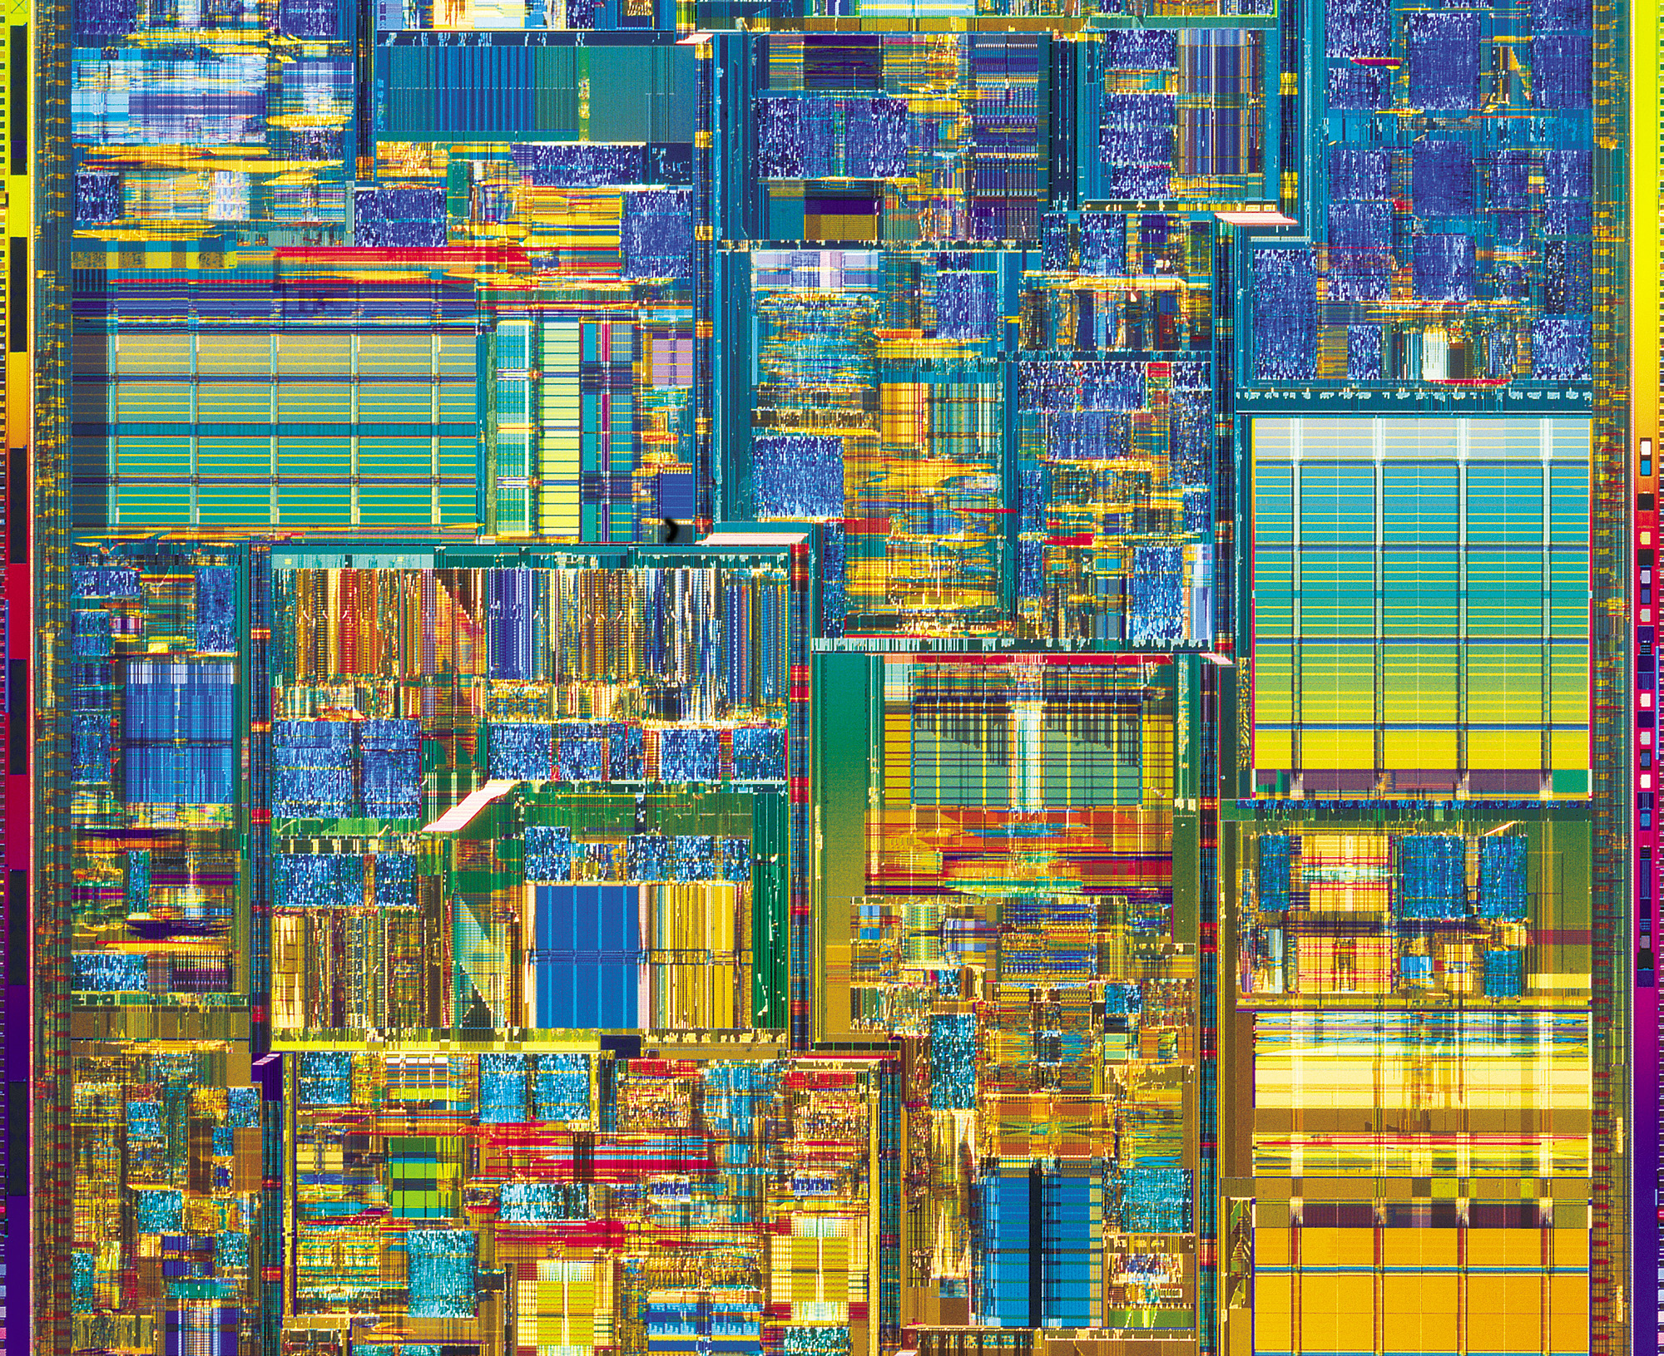
Assumptions in Boolean Network
The state of each gene or other network element can be characterized as either on (one) or off (zero).
The combinational control of gene expression can be reduced to a “wiring diagram” of the network.
The computation of the interactions indicated by the wiring diagram can be approximated by Boolean combinational logic rules.
All elements (to ﬁrst approximation) update their on or off states synchronously.
Software used: D.D.L. (Discrete Dynamics Lab) that computes the behavior of hypothetical networks.

Slide 18
Limitation of Boolean Network
Poor approximation
Notes:
It defines physically based promoter control model for the common operator region of P_{R} and P_{RM} that are central elements of Phage lambda’s so called ‘Switches’.
Figure 2.
The phage λ P_{RM} promoter is controlled by the concentration of both Cro and CI dimers; the promoter activation level in open complexes per second (OC/s), is plotted in the upward or z-direction versus the log of the molar dimer concentrations plotted in the x–y plane. The temporal pattern of P_{RM} promoter activation immediately after phage infection of an E. coli cell depends on the way the concentrations of the controlling effector grows. Arrows illustrate the “path” of P_{RM} activation for a lysogenic outcome (a) and a lytic outcome (b). Each cell starts from the (1 nM Cro2, 1 nM CI2) point marked with S at the right rear of a and b. (In an E. coli cell, one molecule/cell is roughly equivalent to a 1 nM concentration.) In the lysogenic case, a, the system eventually enters a region of positive autoregulation locking repressor production on, while in the lytic case, b, repressor production from P_{RM} is never activated.

Slide 19
Together, they are known as HTH (Helix-Turn-Helix) superfamily.
Bacteriophage λ encodes two repressor proteins
Cro repressor acts to turn off early gene transcription during lytic cycle
CI repressor maintains lysogenic growth

Slide 20
Other control mechanism
Termination sites activation control
Many post-transcriptional regulations
Many protein-mediated controls
Proteolysis
Phosphorylation
Methylation

Slide 21
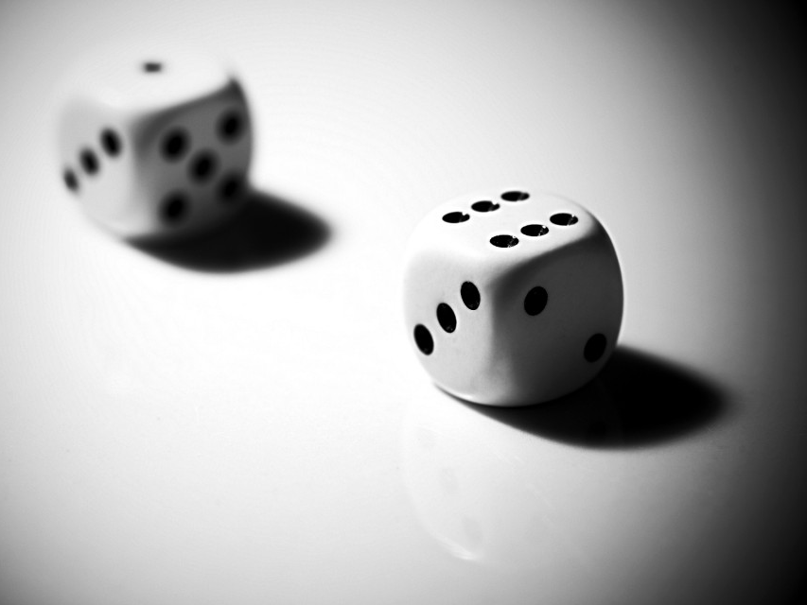
Stochastic Process
Model macroscopic kinetics of chemical reactions using ordinary differential equations
Difficult to achieve in genetic reaction due to spatial isolation, low concentration and slow reaction rates
Gillespie Algorithm – calculating the probabilistic outcome of each discrete chemical event
State vector characterize the states of the system.

Slide 22
There are two fundamental ways to view coupled systems of chemical equations:
Continuous, represented by differential equations whose variables are concentrations
Discrete, represented by stochastic processes whose variables are numbers of molecules.

Slide 23
Gillespie Algorithm
Stochastic realization of temporal behavior of the system
Calculating the probabilistic outcome of each discrete chemical event
Resulting changes in the number of each molecular species
Based on the application of CME (chemical master equation)

Slide 24
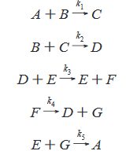
Gillespie Algorithm
Consider, for example,
the set of reactions. The propensities of the reactions are given by k₁, k₂, …k₅. The constants k_{i} may be a function of temperature, volume, electrolyte concentration etc.

Slide 25
Gillespie Algorithm
Gillespie proposed two exact stochastic simulation algorithms.
Consider a system of r reactions and assume every rate constant k_{i} are true constants.
At each time step, the system is in exactly one state. A transition consists of executing a reaction so there are at most r possible transitions from a given state.
The key is to choose random numbers using a computer random number generator and to use those random numbers to pick transitions.

Slide 26
Gillespie Algorithm
Direct Method
Calculates explicitly which reaction occurs next and when it occurs
First Reaction Method
Generates for each reaction μ a putative time τ_{μ} at which reaction μ occurs, then chooses the reaction μ* with the smallest time τ_{μ}* (the first reaction) and executes reaction μ* at time τ_{μ}*

Slide 27
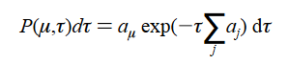
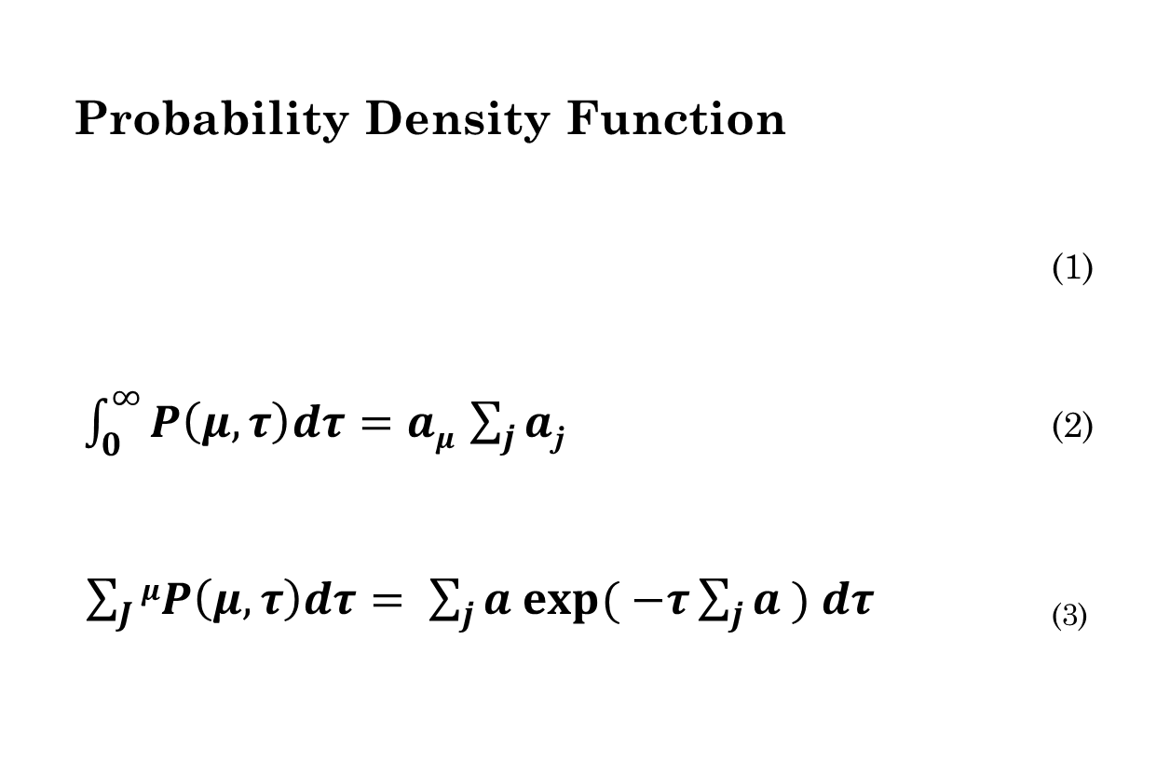
Gillespie Algorithm : Direct Method
Probability Density Function
(1)
$\int_{0}^{∞}{P\left(μ,τ\right)dτ=aμ }\sum_{j}{a}$_{j} (2)
$\sum_{J}{μP\left(μ,τ\right)dτ= \sum_{j}{a exp{( −τ\sum_{j}{a}}}} ) dτ$ ₍₃₎

Slide 28
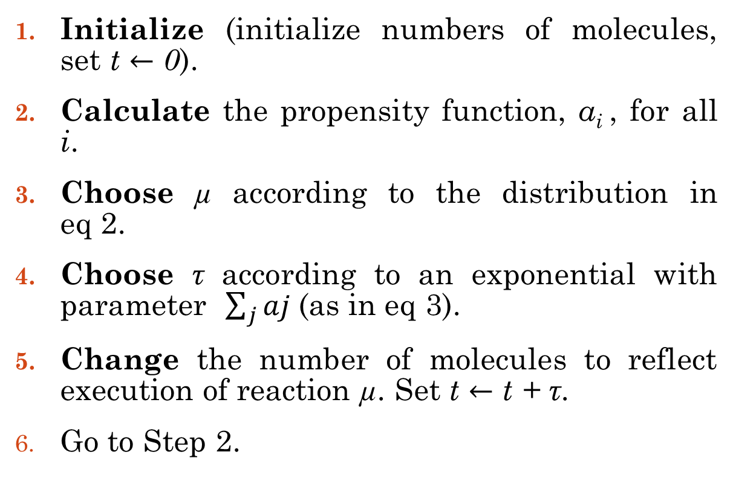
Gillespie Algorithm : Direct Method
Initialize (initialize numbers of molecules, set t $←$ 0).
Calculate the propensity function, a_{i} , for all i.
Choose µ according to the distribution in eq 2.
Choose τ according to an exponential with parameter $\sum_{j}{aj }$(as in eq 3).
Change the number of molecules to reflect execution of reaction µ. Set t $←$ t + τ.
Go to Step 2.

Slide 29
Gillespie Algorithm : First Reaction Method
Generates a putative time τ_{i} for each reaction to occur - a time the reaction would occur if no other reaction occurred first - then lets µ be the reaction whose putative time is first, and lets τ be the putative time τ_{μ}.
The algorithm of the previous subsection is direct in the sense that it generates µ and τ directly.

Slide 30
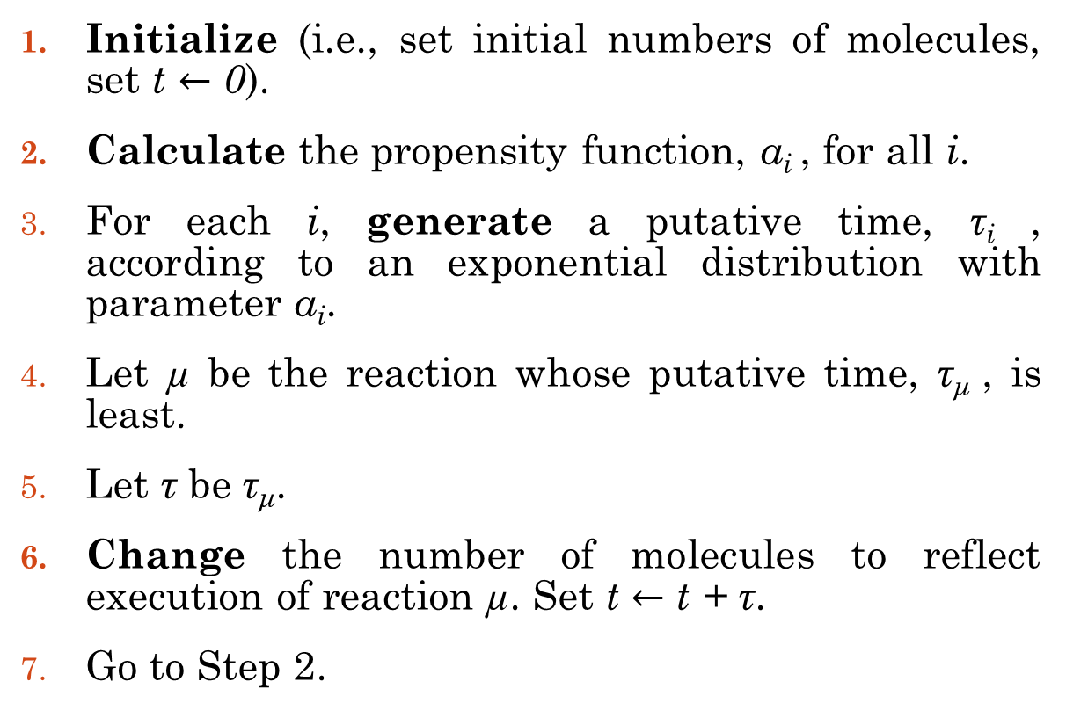
Gillespie Algorithm : First Reaction Method
Initialize (i.e., set initial numbers of molecules, set t $←$ 0).
Calculate the propensity function, a_{i} , for all i.
For each i, generate a putative time, τ_{i} , according to an exponential distribution with parameter a_{i}.
Let µ be the reaction whose putative time, τ_{μ} , is least.
Let τ be τ_{μ}.
Change the number of molecules to reflect execution of reaction µ. Set t $←$ t + τ.
Go to Step 2.

Slide 31
Gillespie Algorithm : First Reaction Method
This algorithm uses r random numbers per iteration (where r is the number of reactions), takes time proportional to r to update the a_{i} s, and takes time proportional to r to identify the smallest τ_{μ}.

Slide 32
Stochastic Process
Random burst of numbers of protein
Timing uncertainty
Stronger promoter
Higher gene dosage
Lower signal threshold
Notes:
Figure 3.
(a) Three simulation runs showing a different realization of the pattern of homodimer production from a representative bacterial promoter in a single cell. Dashed lines, declining concentrations equivalent to 25 and 50 dimer molecules in the growing cell.
Parameters: Dimerization equilibrium constant = 20 nM
protein half-life = 30 min
Initial cell volume = 1 × 10−15 l, doubling in 45 min.
(b) Mean and ±1 σ results at gene dosages of 1, 2, and 4. At higher gene dosages, protein P1 is being produced from more genes; the concentration rises more rapidly, and the effective concentration range is reached quicker. Also, the dispersion in time to effectiveness (i.e. the switching delay) is lower for faster-growing signals

Slide 33
Stochastic Process
Different Activation time due to variation of the concentration
Notes:
Figure 4.
Illustration of differential promoter activation across a cell population resulting from statistical variations in concentrations of competitive effectors. The activator and repressor operons shown are assumed to be independent so that stochastic gene expression mechanisms in each operon produce the respective protein types in a different pattern in each cell. Small circular contour patterns, concentration distributions with increasing means at successive times T₁ ,T₂ and T₃ after activation of P_{A} and P_{R} at T₀. Contours of the illustrative activation surface for P_{G} as a function of activator and repressor concentration are also shown. Bold line, 50% activation contour for promoter P_{G}. This simple example illustrates how normal dispersion of concentrations of controlling proteins can result in differential activation of controlled operons in different cells. Consequences for the cell will depend on the speciﬁc kinetic parameters for a particular case and, importantly, on the larger regulatory circuit responding to proteins from the controlled operons.

Slide 34
Modelling macromolecular complex
Realistic Modelling | Central Challenge
Complicated network mechanism
Dynamic behaviour

Slide 35
Uncertainty of Intracellular Reaction Features
Stochastic Variations
Poorly Characterized
Varies widely in cells

Slide 36
Challenges
PTM message processing
Complex Regulons
Eukaryotic Networks
Category

Slide 37
Opportunities
1
To recognize Common Circuit Motifs.
2
To identify function of individual protein in regulatory control mechanisms.
3
To redesign circuit for altered functions.

Slide 38
References
McAdams, H. H. and A. Arkin (1998). "Simulation of prokaryotic genetic circuits." Annu Rev Biophys Biomol Struct 27: 199-224.
Gillespie, D. T. (1992). "A rigorous derivation of the chemical master equation." Physica A: Statistical Mechanics and its Applications 188(1): 404-425.
Gibson, M. A. and J. Bruck (2000). "Efficient Exact Stochastic Simulation of Chemical Systems with Many Species and Many Channels." The Journal of Physical Chemistry A 104(9): 1876-1889.

Slide 39
Further Readings
Smadbeck, P. and Y. N. Kaznessis (2014). "Solution of Chemical Master Equations for Nonlinear Stochastic Reaction Networks." Curr Opin Chem Eng 5: 90-95.
Gillespie, D. T. (1976). "A general method for numerically simulating the stochastic time evolution of coupled chemical reactions." Journal of Computational Physics 22(4): 403-434.
Gillespie, D. T. (1977). "Exact stochastic simulation of coupled chemical reactions." The Journal of Physical Chemistry 81(25): 2340-2361.
Miller, M. B. and B. L. Bassler (2001). "Quorum sensing in bacteria." Annu Rev Microbiol 55: 165-199.
Shea, M. A. and G. K. Ackers (1985). "The OR control system of bacteriophage lambda. A physical-chemical model for gene regulation." J Mol Biol 181(2): 211-230.

Slide 40
Brophy, J. A. N. and C. A. Voigt (2014). "Principles of genetic circuit design." Nat Meth 11(5): 508-520.
Gillespie, D. T. (1976), 'A general method for numerically simulating the stochastic time evolution of coupled chemical reactions', Journal of Computational Physics 22 (4), 403-434.
Gillespie, D. T. (2007). "Stochastic simulation of chemical kinetics." Annu Rev Phys Chem 58: 35-55.
Li, H., et al. (2008). "Algorithms and software for stochastic simulation of biochemical reacting systems." Biotechnol Prog 24(1): 56-61.
Hyver, C. and H. Le Guyader (1990). "MPF and cyclin: modelling of the cell cycle minimum oscillator." Biosystems 24(2): 85-90.

Slide 41
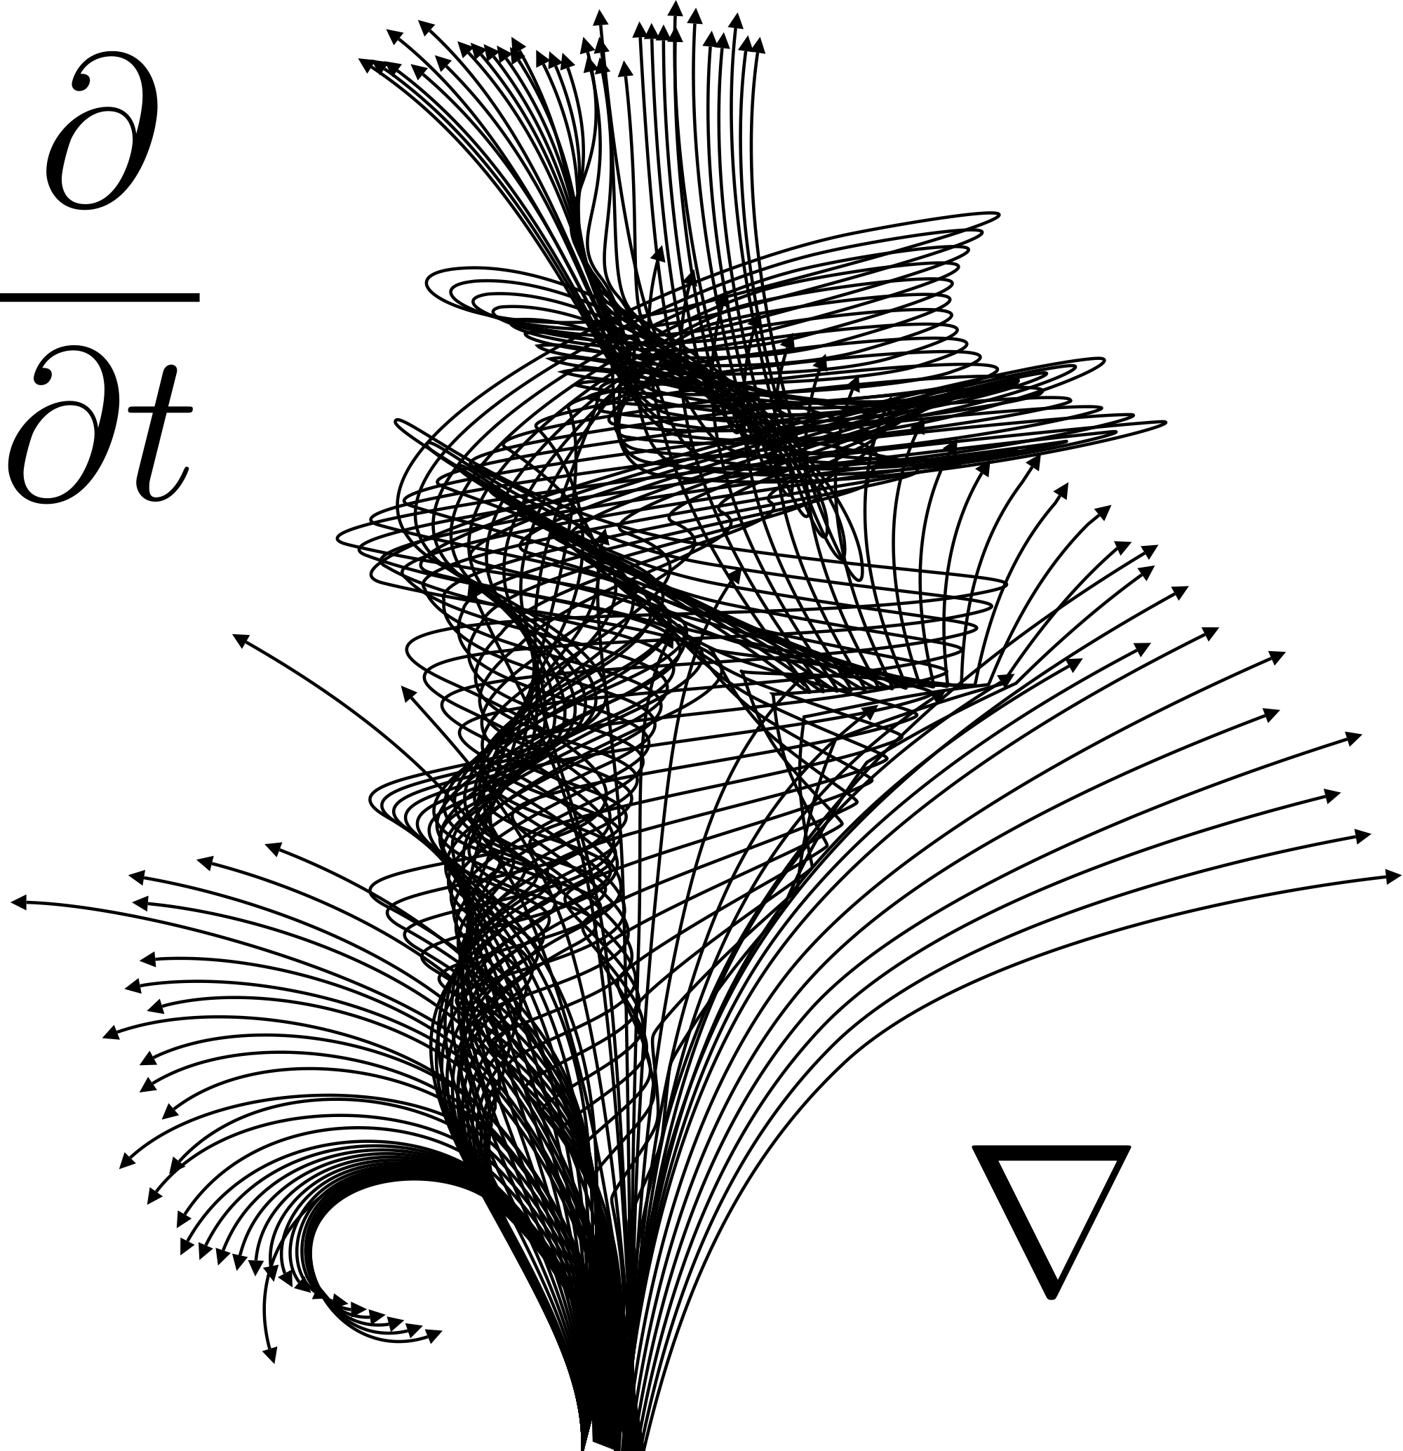
Thank You.

